Slide 1

Presentation
On
Student Data Management System
By
ABHIRAJ BANERJEE (221210005)
ADITYA NAYAK (221210009)
AKSHAT (221210014)
ANISH KUMAR (221210019
ANKIT PAL (221210021)
National Institute of Technology Delhi

Slide 2
CONTENTS
INTRODUCTION
PROJECT GOALS
FLOW OF CONTROL
MENU INTERFACE AND WORKING
RESULTS
CONCLUSION
FUTURE ENHANCEMENTS AND POTENTIAL EXTENSIONS
REFERENCES
National Institute of Technology Delhi

Slide 3
INTRODUCTION
Student Data Management System in C programming language.
Designed to manage student data efficiently and store it in files.
It provides a range of functions to input, retrieve, and display student information.
Categorize the data in many ways.
File handling
National Institute of Technology Delhi

Slide 4
PROJECT GOALS
Develop a fully functional student data management system
Implement the data and mechanics accurately.
Categorize and display the data of each student.
Provide a user-friendly interface for entering the data.
Allow users to track the progress.
National Institute of Technology Delhi

Slide 5
FLOW OF CONTROL
National Institute of Technology Delhi

Slide 6
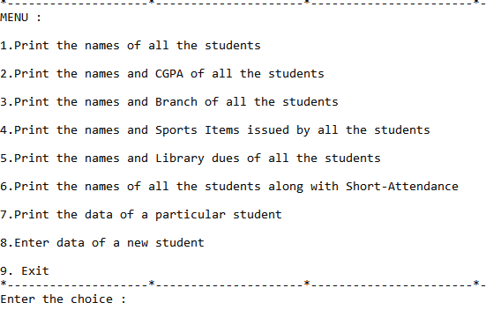
MENU INTERFACE
National Institute of Technology Delhi

Slide 7

National Institute of Technology Delhi

Slide 8
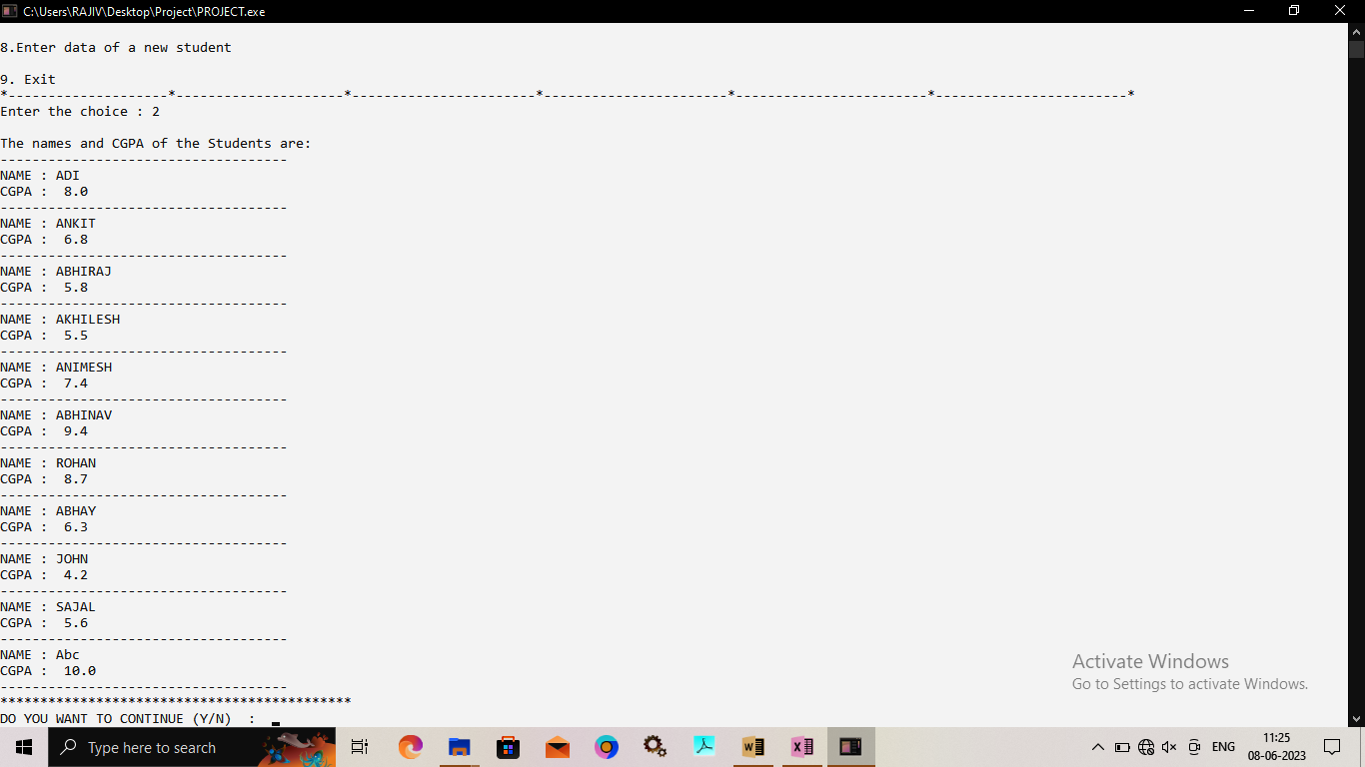
National Institute of Technology Delhi

Slide 9

National Institute of Technology Delhi

Slide 10

National Institute of Technology Delhi

Slide 11

National Institute of Technology Delhi

Slide 12
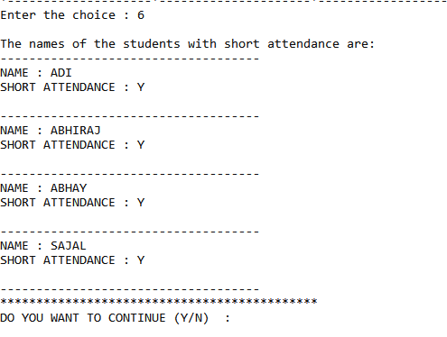
National Institute of Technology Delhi

Slide 13
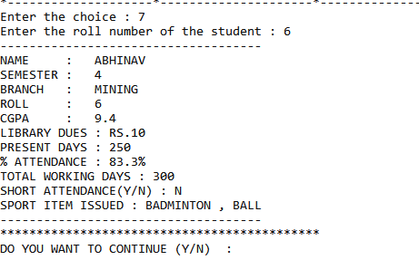
National Institute of Technology Delhi

Slide 14

National Institute of Technology Delhi

Slide 15
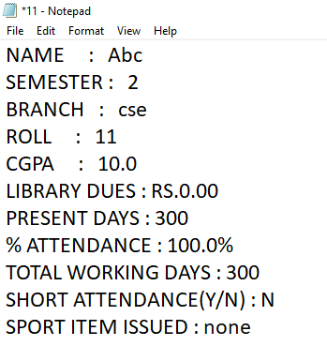
HOW THE DATA IS STORED IN FILE
National Institute of Technology Delhi

Slide 16
RESULTS
Quick access to information: You can retrieve specific information about a student, such as their name, CGPA, branch, sports items issued, library dues, and attendance.
Scalability: The system can handle data for multiple students, making it suitable for various educational institutions.
Customizable reports: The program allows you to generate reports based on your specific needs, making it easier to analyze and present student data.
National Institute of Technology Delhi

Slide 17
CONCLUSION
Our Student Data Management System provides an efficient solution for managing student data.
It simplifies data entry, retrieval, and reporting, saving time and effort for educational institutions.
Whether you need to maintain records, generate reports, or access student information, this system can fulfill your requirements.
National Institute of Technology Delhi

Slide 18
FUTURE ENHANCEMENTS AND POTENTIAL EXTENSIONS
Adding customizable options, such as the ability to check how many classes to attend to prevent short attendance.
Implementing a multi user mode, either locally or online, to allow users to enter and access data from anywhere.
Enhancing the graphical user interface (GUI) with animations, graphs, and visual feedback to enhance the overall understanding experience.
Conducting additional testing and gathering user feedback to identify and address any potential issues or areas for improvement.
National Institute of Technology Delhi

Slide 19
REFERENCES
https://www.geeksforgeeks.org/basics-file-handling-c/ for learning file handling.
https://www.javatpoint.com/file-handling-in-c for gaining basic knowledge about functions in file handling.
Book-Let Us C by Yashavant Kanetkar
National Institute of Technology Delhi

Slide 20
Thank You
National Institute of Technology Delhi

